Slide 1


Slide 2










Introduction
1. Data Collection and Research
2. Data Preprocessing and Exploratory Analysis
3. Model Building
4. Dashboard Creation
5. Conclusion

Slide 3

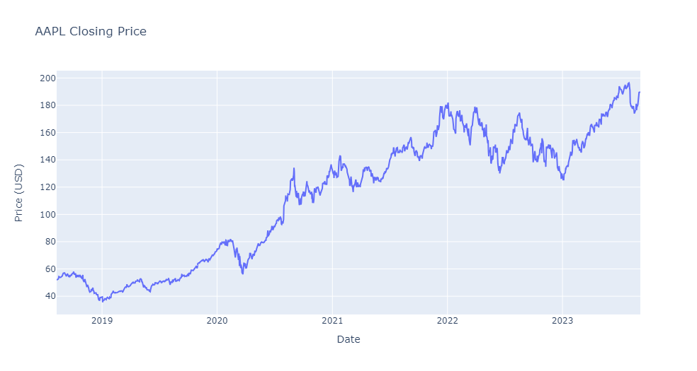
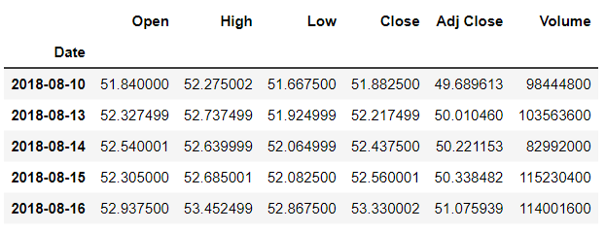

Data Collection and Research
Data is downloaded from yahoo finance UK website: https://uk.finance.yahoo.com/

Slide 4

Data Preprocessing and Exploratory Analysis
The required data points are Date and Closing price
The data is complete for the dates on which it is available. (That means there are no NA values in the data)
There are gaps in the dates with no available data for some entries in the time series. These gaps cannot be attributed to weekends alone.
It is possible that the missing data is due to holidays or other events that caused the market to be closed on those days:
Cleaning the dataset
Filling in the missing data
Doing the simple statistical analysis

Slide 5
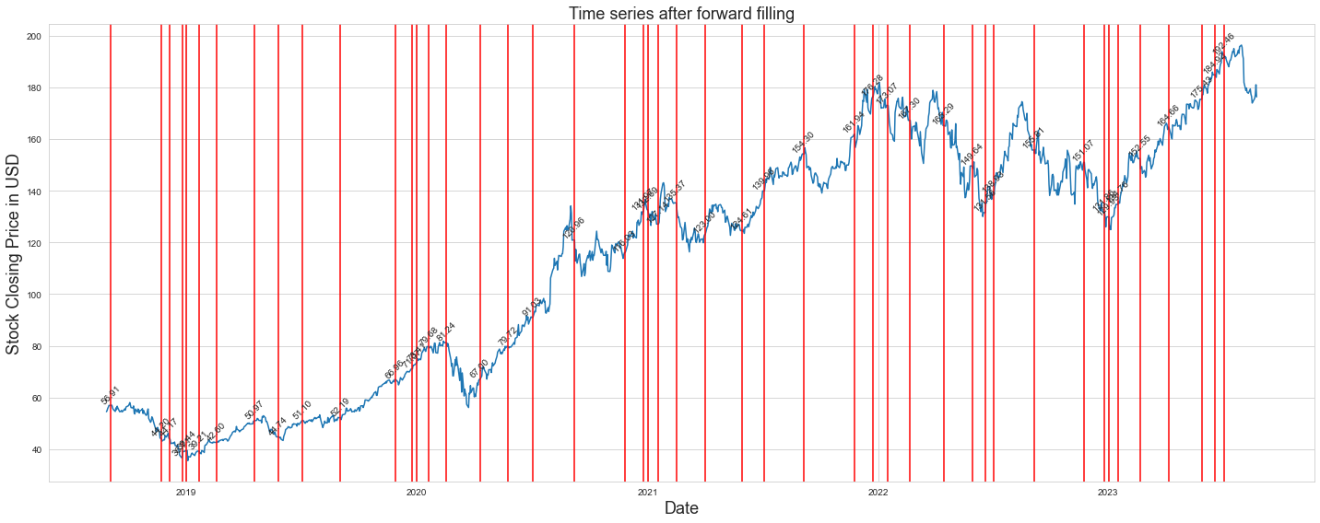
Using Forward Filling - This approach involves filling in missing values by the closest in time past existing value. This is a simple and intuitive approach, and it can work well if the missing values are likely to be like the preceding values. However, it can also lead to errors if the values are not actually similar, and it can amplify any errors or outliers that may exist in the data.
Bank Holidays
National Holidays
Unexpected Closures

Slide 6
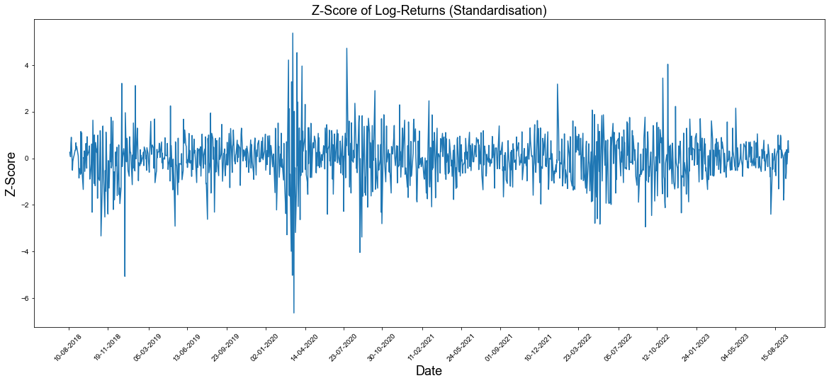

Data Normalization
Log-Return = log(Close price) /Close price+1
Mean = Log-Return/n
Variance (σ²=)(1/n) ∑^{n}_{i=1} (log(Ci/Ci−1)) ²
Standard Deviation(σ) = √variance

Slide 7

Model Building
ARIMA Modelling and Forecasting
AutoRegressive (AR) component: It models the relationship between the current value and previous values in the time series.
Integrated (I) component: It represents the differencing of the series to make it stationary. Differencing involves subtracting a lagged value from the current value.
Moving Average (MA) component: It models the relationship between the current value and past prediction errors (residuals).

Slide 8
Model Building
Splitting the time series data into a training set
Estimate the ARIMA parameters
(p, d, q) on the training set.
Fitting the ARIMA model to the training data.
Training the model
!pip install pmdarima

Slide 9
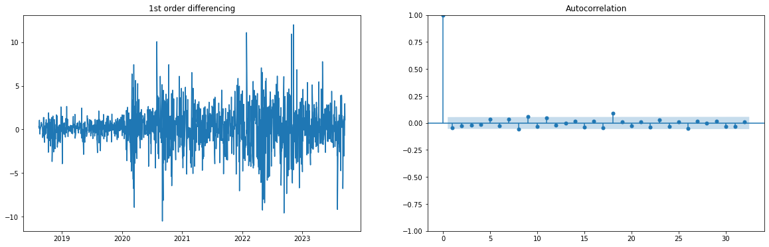
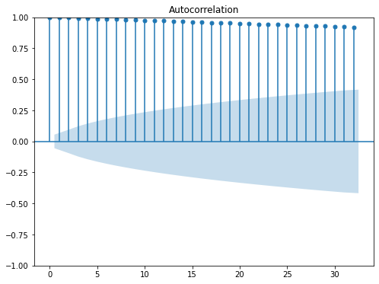
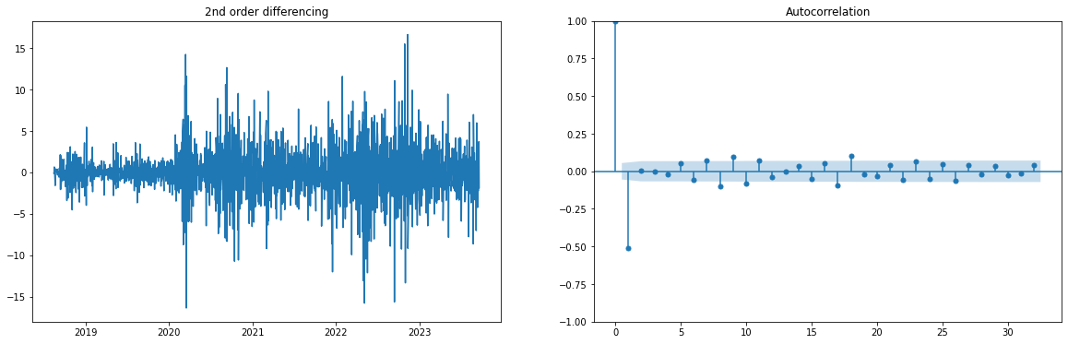
ARIMA Model parameters
Autocorrelation plot
(ACF)
Using Augmented Dickey-Fuller test to estimate d value
P-value(0) | 0.817169
P-value(1) | 0.0
P-value(2) | 2.005226396759131e-24

Slide 10

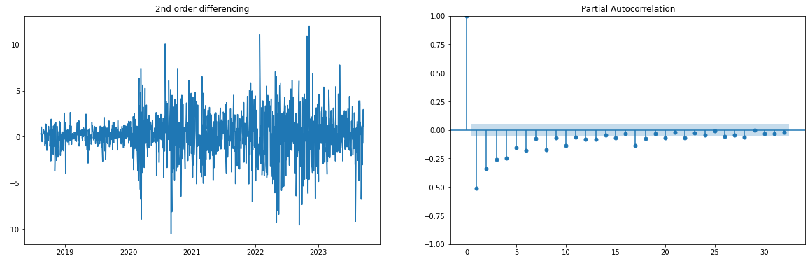
ARIMA Model parameters
Partial Autocorrelation plot (PACF)
(q) can be estimated similarly by looking at the ACF plot instead of the PACF plot.

Slide 11
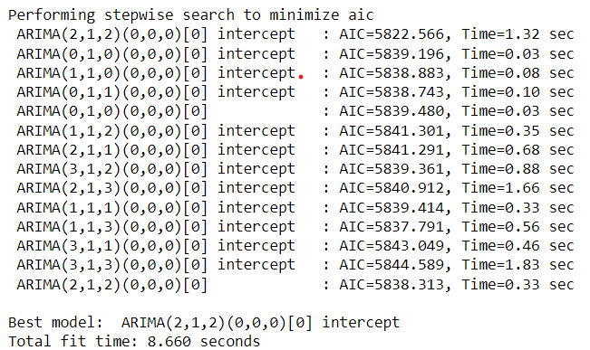
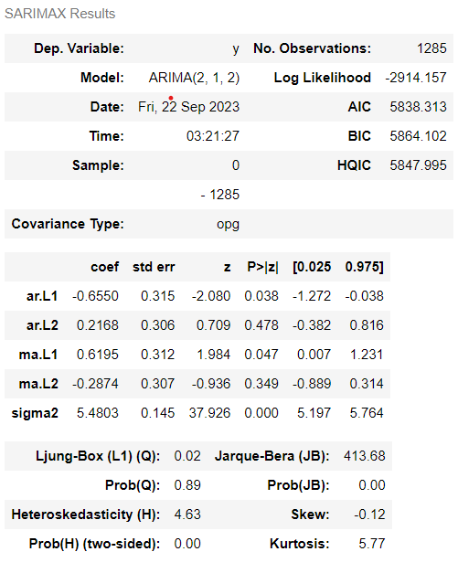
ARIMA Model parameters
Using Auto ARIMA for Stepwise fit
Fitting the data into the model in order(2,1,2)

Slide 12
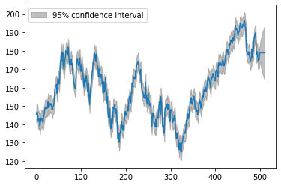
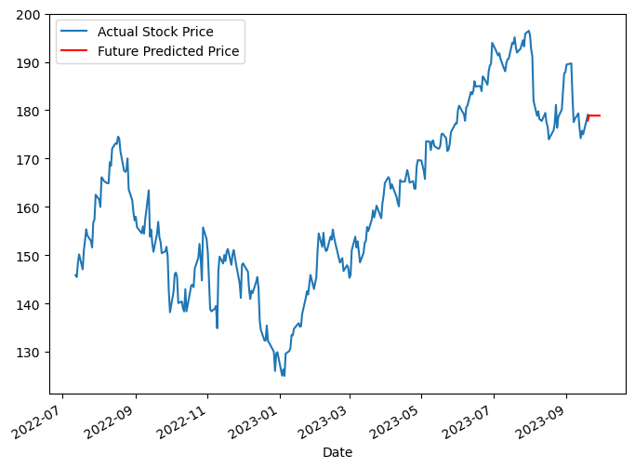
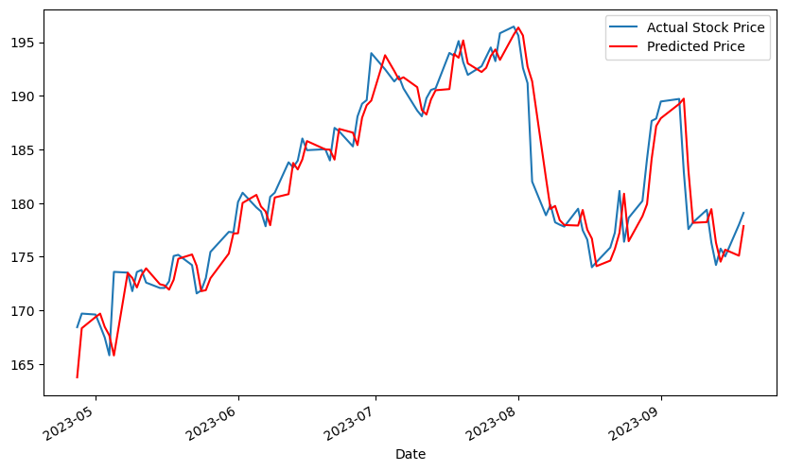
Model Predictions
Best Model (2, 1, 2)

Slide 13
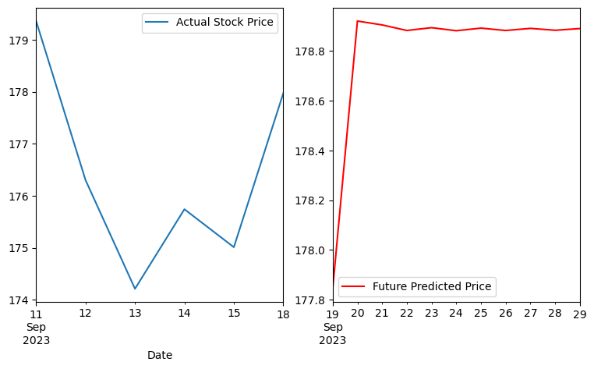
Model Predictions
Predicting Future 10 values
Metric Data for AAPL stock (Default)
Mean | 0.0009
Variance | 0.0004
Std Deviation | 0.0208
Percentage Inc in {user input} years | 345%
Mean Squared Error | 2.3425
Mean Absolute Error | 1.3005
Rsquared | 0.9128

Slide 14
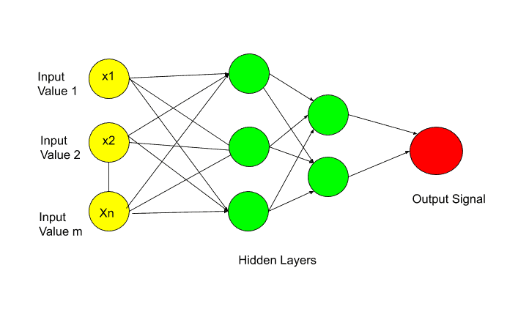
Model 2
LSTM(LONG SHORT-TERM MEMORY)
Sequential Data Handling
Memory of Long-Term Dependencies
Time Series Forecasting

Slide 15
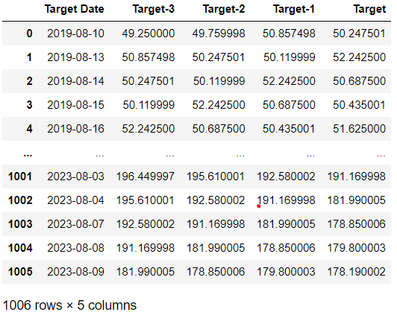
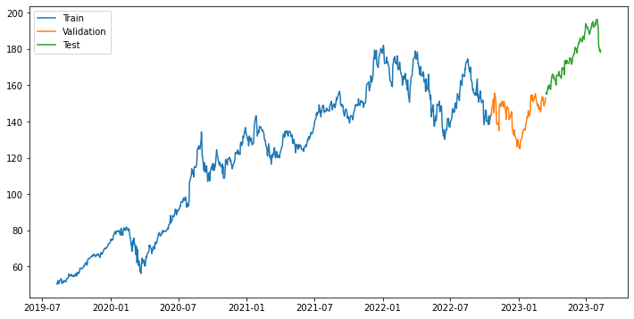
LSTM Model Building
Splitting the data

Slide 16
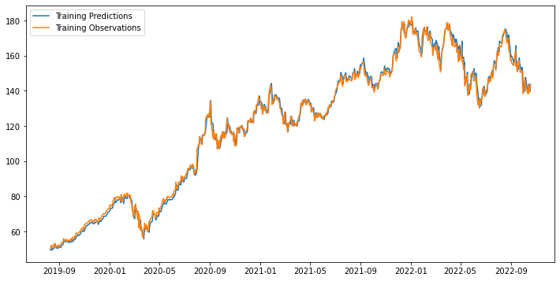
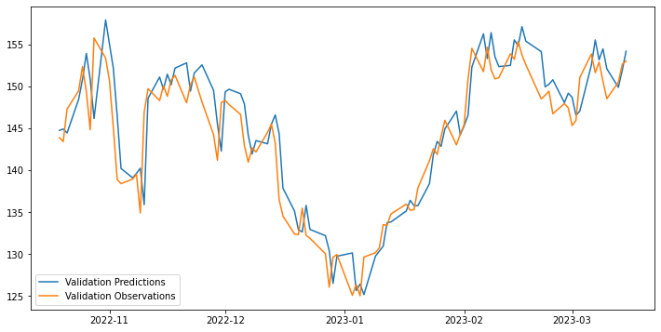
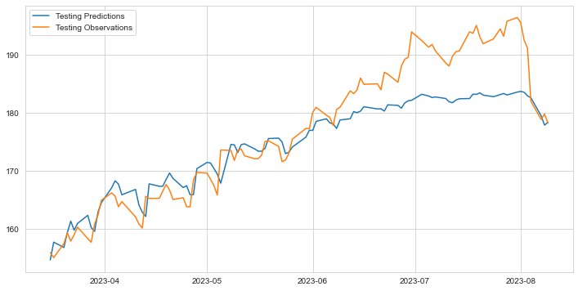
LSTM Model Building
Training Predictions
Validation Predictions
Testing Predictions

Slide 17
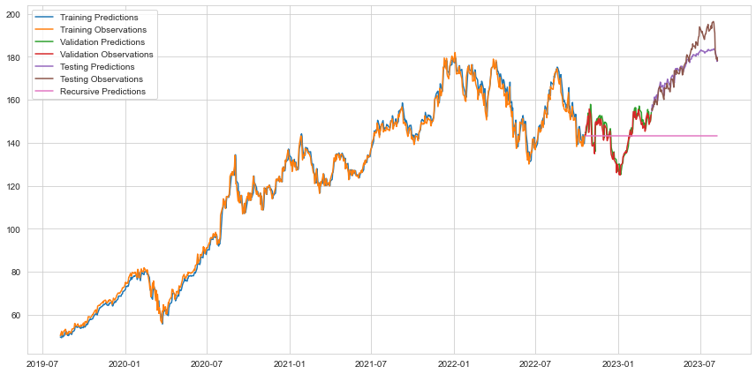
LSTM Model Building
Final Model Predictions: Using Deepcopy to make recursive predictions
Mean absolute error: | 2.2763
Validation loss: | 11.0968
Mean absolute error: | 2.5395

Slide 18



Platform Building
For creating an interactive dashboard, I used Plotly, Dash, yfinance, and an ARIMA model to predict stock price value. ARIMA models require data preprocessing and model training, which can be complex.
pip install streamlit plotly yfinance
Streamlit run ‘file_name’.py, this will launch a local web app where you can enter a stock symbol in the sidebar, and it will display an interactive Plotly plot of the closing price for the selected stock along with metric data and predictions to show where the stock is headed.
https://streamlit.io/

Slide 19
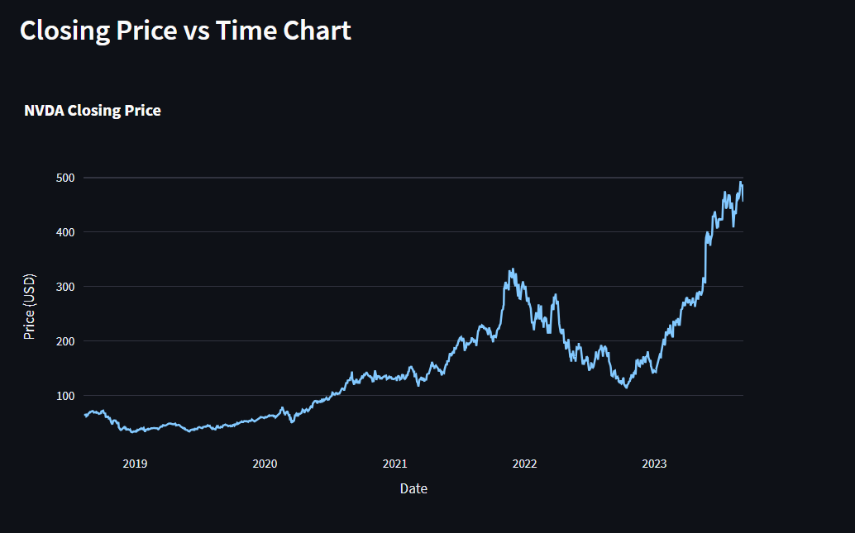
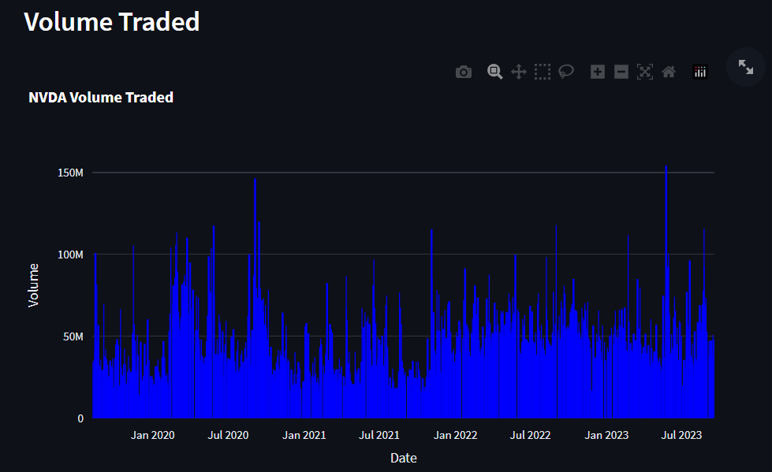
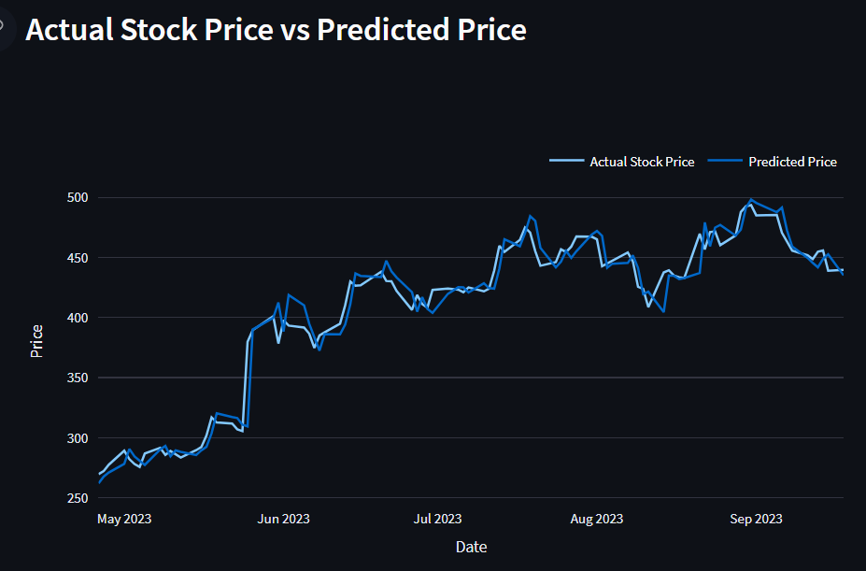
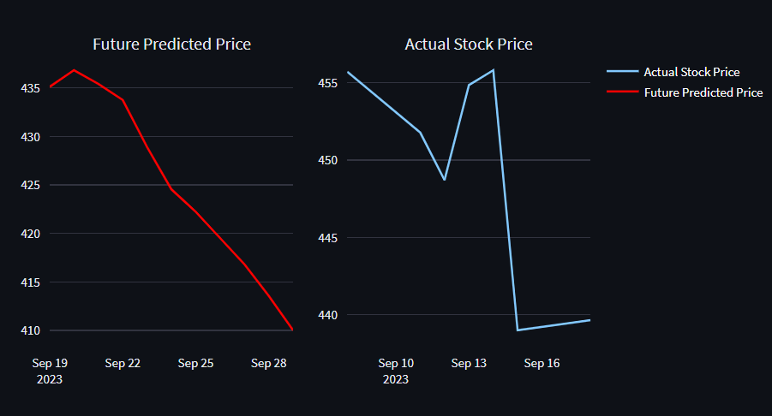
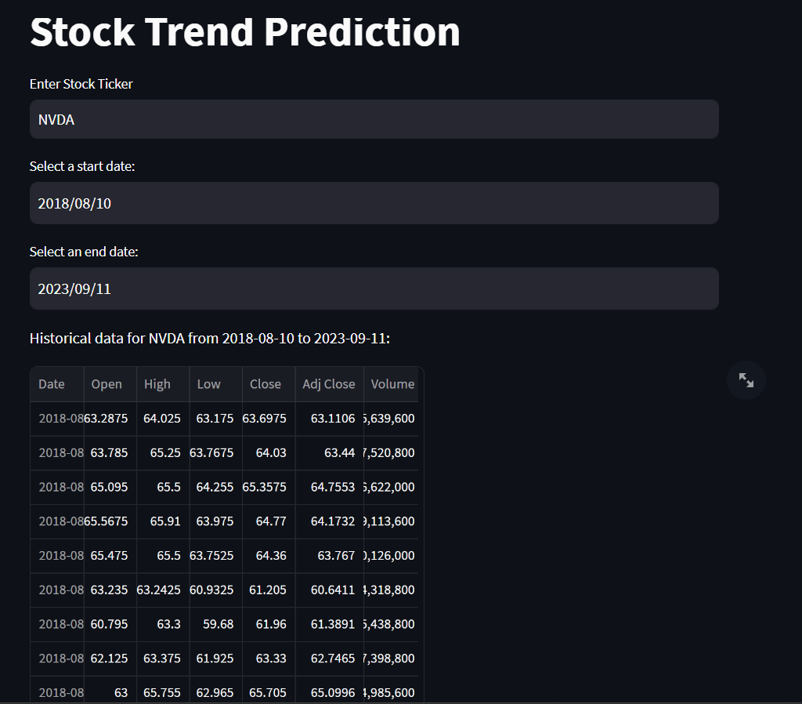
Dashboard

Slide 20


Conclusion
Predictions should be used in conjunction with other financial analysis and risk management strategies.
Future work may involve exploring alternative time series forecasting methods, incorporating additional data sources, and refining the model to improve predictive accuracy and robustness.
ARIMA model represents a valuable step towards understanding and predicting closing price value, but it should be used judiciously and in conjunction with a comprehensive financial analysis approach.
Thank you

